Slide 1

Discussion topic
How are AWERBs fulfilling the task of assisting with the retrospective assessment of projects involving severe procedures?

Slide 2
Retrospective assessment
All projects involving severe procedures must be assessed retrospectively (and projects of any severity that use non-human primates, cats, dogs or equidae)
A formal assessment of specific types of
projects, either during or at the end, to determine, amongst other things, whether
the objectives have been achieved and whether lessons can be learnt to further the
implementation of the 3Rs

Slide 3
Project licence holders tell the AWERB:
whether the work has been carried out;
whether the objectives have been achieved;
the amount of harm caused to animals (including numbers, species and severity; and
whether any lessons can be learnt from the programme of work which may contribute to the further implementation of the 3Rs
… and they must provide an updated NTS

Slide 4
Retrospective assessment
This will enable your AWERB to retrospectively assess your project including the harms and benefits
As soon as your AWERB has completed its retrospective assessment we will require you to submit to us the AWERB’s conclusions, together with the updated NTS agreed with the AWERB, in order that an inspector can complete the assessment on behalf of the Secretary of State
ASRU Guidance on the operation of ASPA

Slide 5
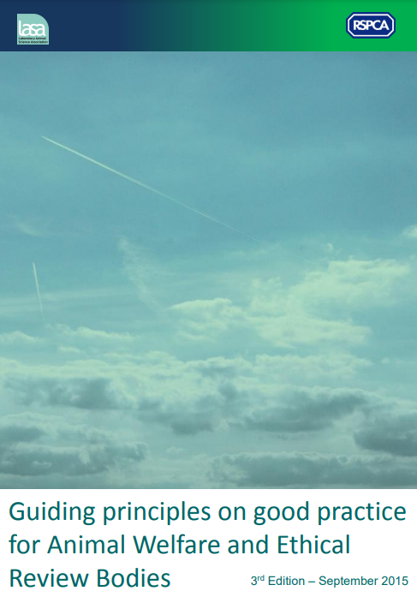
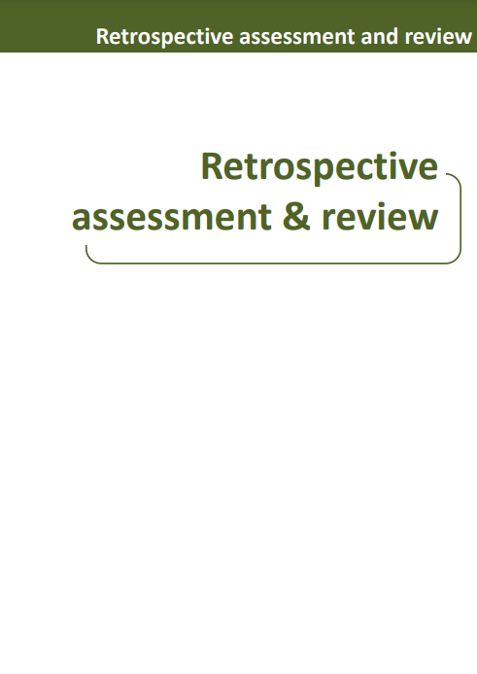
tinyurl.com/RSPCA-LASA-GP

Slide 6
Some example outcomes from GPG
Development of more humane endpoints through use of imaging techniques
Refined welfare assessment using observed clinical signs
Reduction in use of foot pad inoculations to stimulate immune responses by demonstrating efficacy of a less painful route

Slide 7
Over to you …
How are your AWERBs fulfilling the task of assisting with retrospective assessment?
  What kinds of forms and processes do you have in place?
  Do project licence holders attend and discuss with you?
  Are 3Rs learnings effectively captured and disseminated? How?
  What works well, and what do you think could be done better?
  What one thing would you change?

